Slide 1

Algorithm Design IT-2101 Lecture 4
Dr. Mohammad Abu Yousuf

Slide 2
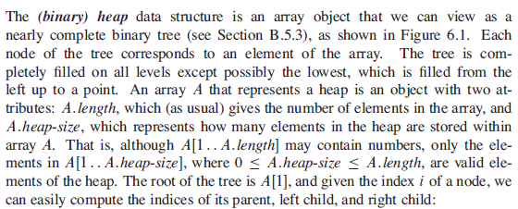
Heap

Slide 3
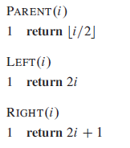
Heap

Slide 4
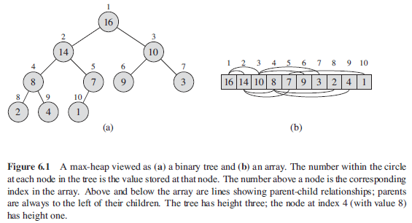
Heap

Slide 5

Heap
There are two kinds of binary heaps: max-heaps and min-heaps. In both kinds, the values in the nodes satisfy a heap property, the specifics of which depend on the kind of heap.
In a max-heap, the max-heap property is that for every node i other than the root,
That is, the value of a node is at most the value of its parent. Thus, the largest element in a max-heap is stored at the root, and the subtree rooted at a node contains values no larger than that contained at the node itself.

Slide 6

Heap
A min-heap is organized in the opposite way; the min-heap property is that for every node i other than the root,
The smallest element in a min-heap is at the root.
For the heap-sort algorithm, we use max-heaps. Min-heaps commonly implement priority queues.
We shall be precise in specifying whether we need a max-heap or a min-heap for any particular application, and when properties apply to either max-heaps or min-heaps, we just use the term “heap.”

Slide 7
Heap
Viewing a heap as a tree, we define the height of a node in a heap to be the number of edges on the longest simple downward path from the node to a leaf, and we define the height of the heap to be the height of its root.

Slide 8
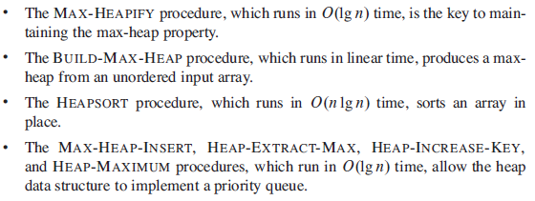
Heap

Slide 9
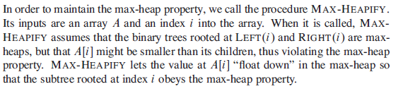
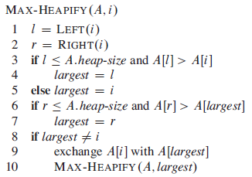
Maintaining the heap property

Slide 10
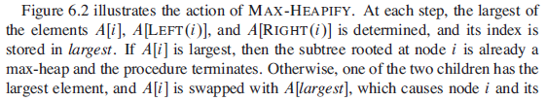

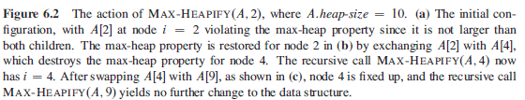

Slide 11
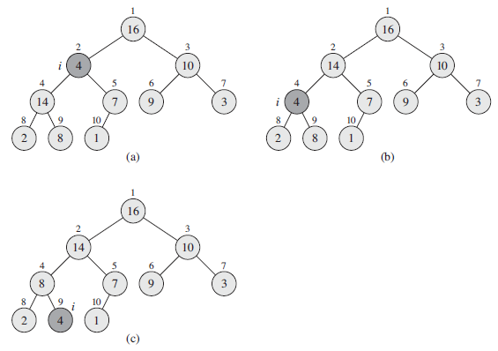
Fig: 6.2

Slide 12
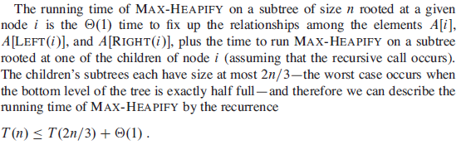

Running Time

Slide 13


Building a heap

Slide 14
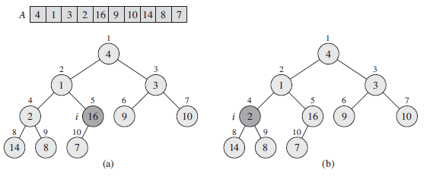
Building a heap
Example: Build Heap

Slide 15
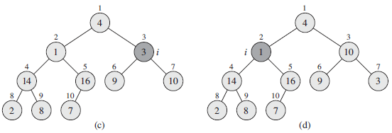
Building a heap

Slide 16
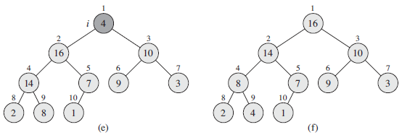
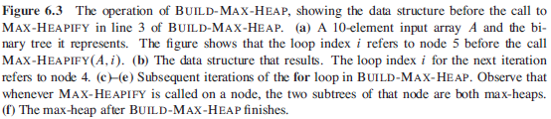
Building a heap

Slide 17

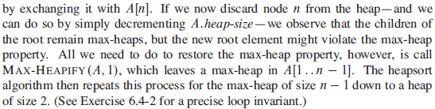
The heapsort algorithm

Slide 18
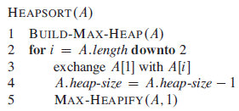
The heapsort algorithm

Slide 19
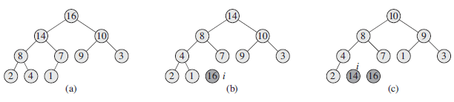
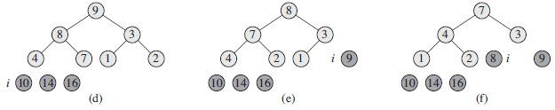
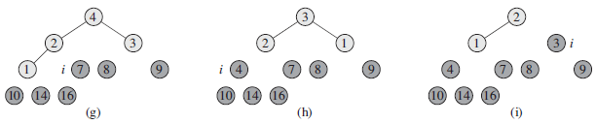

Slide 20
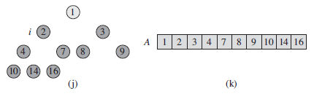

The heapsort algorithm

Slide 21

Running Time

Slide 22
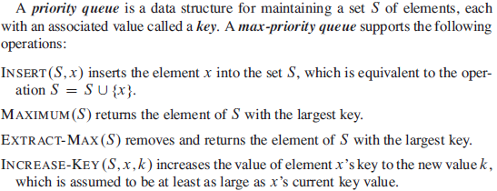
Priority queues

Slide 23
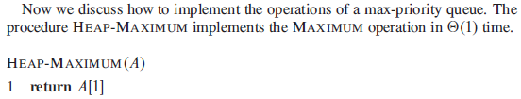
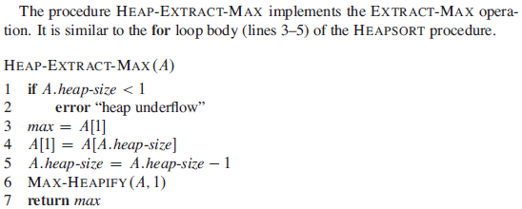
Priority queues

Slide 24
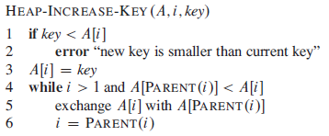

Priority queues

Slide 25
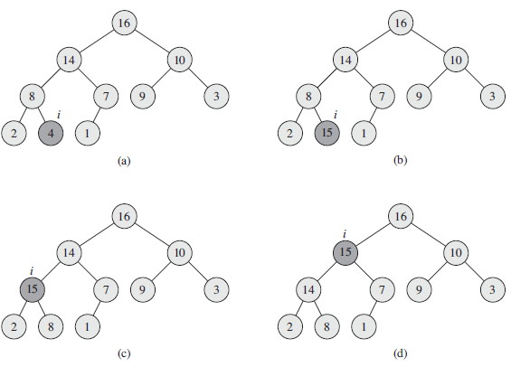


Slide 26
Thank you

